Slide 1
Model Calibration

Slide 2
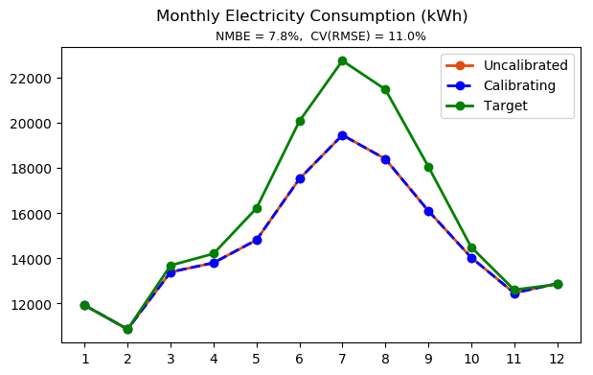
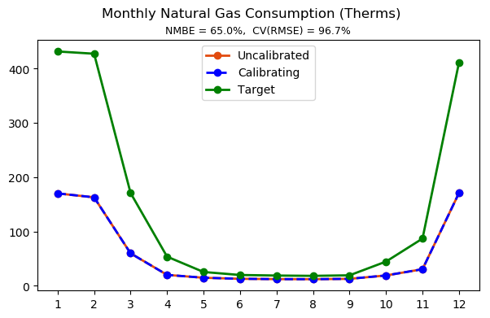
Initial state

Slide 3
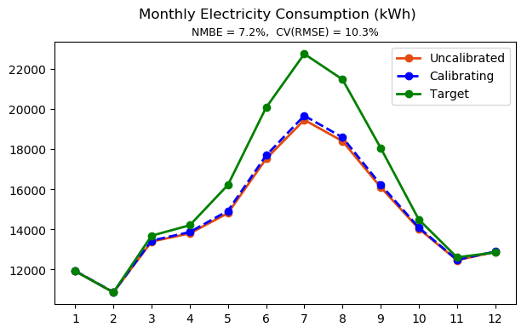
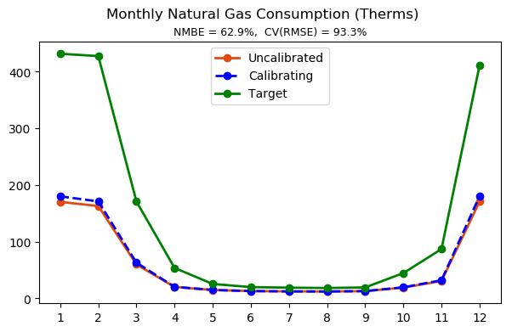
Manual Calibration – model tuning
Step 1
Exterior wall and floor thermal conductivity x 1.5
Exterior wall thickness x 0.8

Slide 4
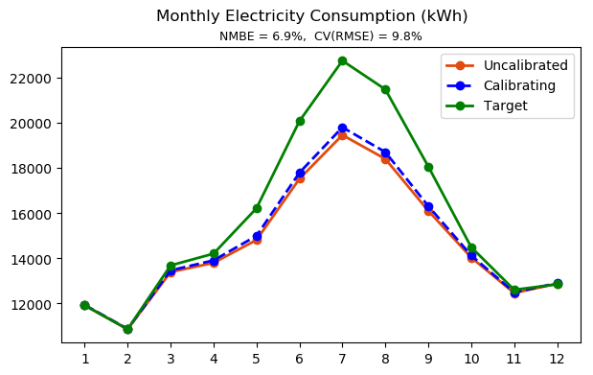
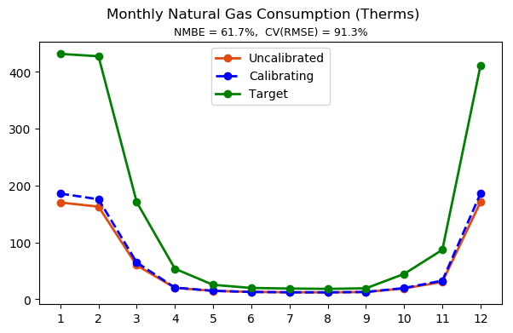
Manual Calibration – model tuning
Step 2
Exterior wall and floor thermal conductivity x 2
Exterior wall thickness x 0.8

Slide 5
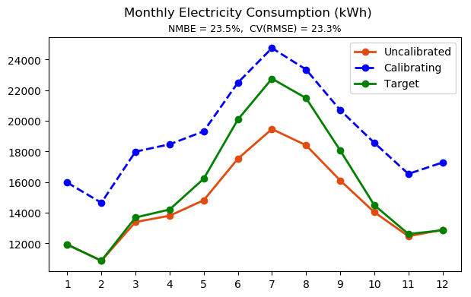
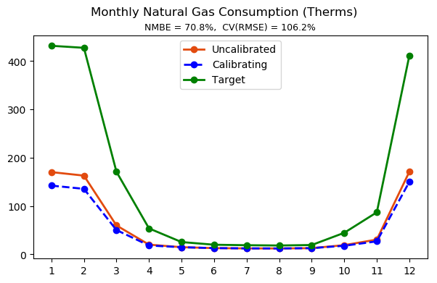
Manual Calibration – model tuning
Step 3
Exterior wall and floor thermal conductivity x 2
Exterior wall thickness x 0.8
Interior lighting and equipment power density x 1.5

Slide 6
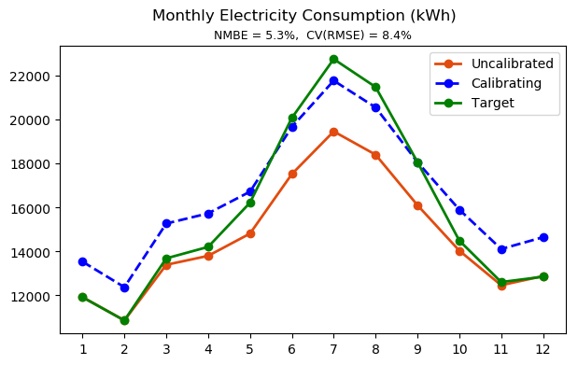
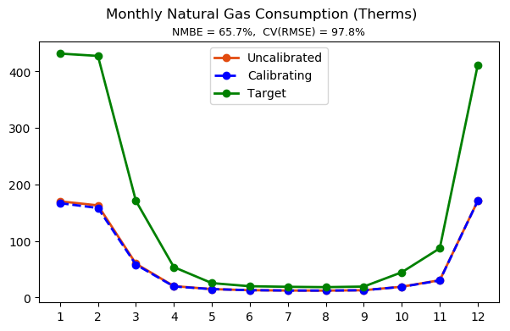
Manual Calibration – model tuning
Step 4
Exterior wall and floor thermal conductivity x 2
Exterior wall thickness x 0.8
Interior lighting and equipment power density x 1.2

Slide 7
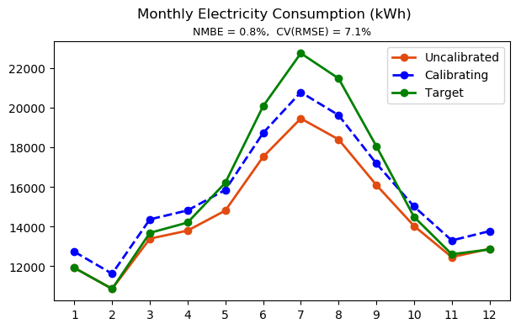
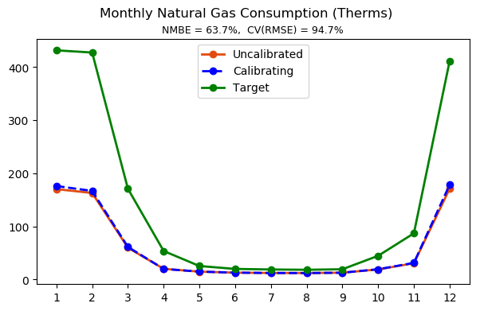
Manual Calibration – model tuning
Step 5
Exterior wall and floor thermal conductivity x 2
Exterior wall thickness x 0.8
Interior lighting and equipment power density x 1.1

Slide 8

Manual Calibration – model tuning
Step 6
Exterior wall and floor thermal conductivity x 2
Exterior wall thickness x 0.8
Interior lighting and equipment power density x 1.1 Boiler and water heater efficiency reduced from 0.78 to 0.75

Slide 9

Manual Calibration – model tuning
Step 7
Exterior wall and floor thermal conductivity x 2
Exterior wall thickness x 0.8
Interior lighting and equipment power density x 1.1 Boiler and water heater efficiency reduced from 0.75 to 0.7
Notes:
Gas consumption still has a huge gap.

Slide 10
Manual Calibration – model tuning
Step 8
Exterior wall and floor thermal conductivity x 2
Exterior wall thickness x 0.8
Interior lighting and equipment power density x 1.1
Boiler and water heater efficiency reduced from 0.75 to 0.7
Occupancy density x 1.5

Slide 11
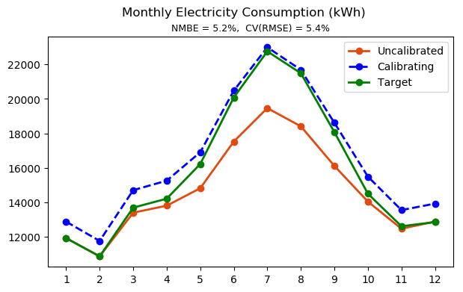
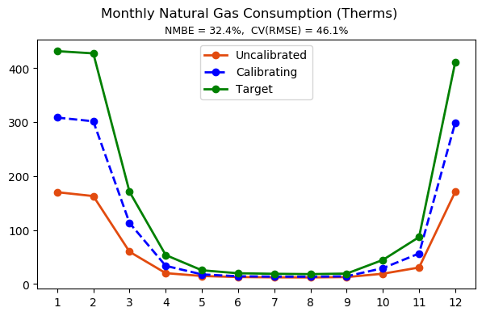
Manual Calibration – model tuning
Step 9
Exterior wall and floor thermal conductivity x 2
Exterior wall thickness x 0.8
Interior lighting and equipment power density x 1.1
Boiler and water heater efficiency reduced from 0.75 to 0.7
Occupancy density x 1.5
Air infiltration rate x 2

Slide 12
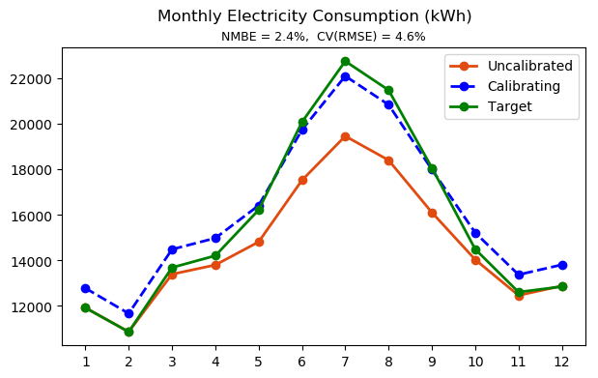
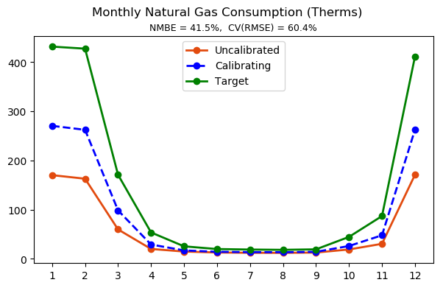
Manual Calibration – model tuning
Step 10
Exterior wall and floor thermal conductivity x 2
Exterior wall thickness x 0.8
Interior lighting and equipment power density x 1.1
Boiler and water heater efficiency reduced from 0.75 to 0.7
Occupancy density x 1.5
Air infiltration rate x 1.5

Slide 13
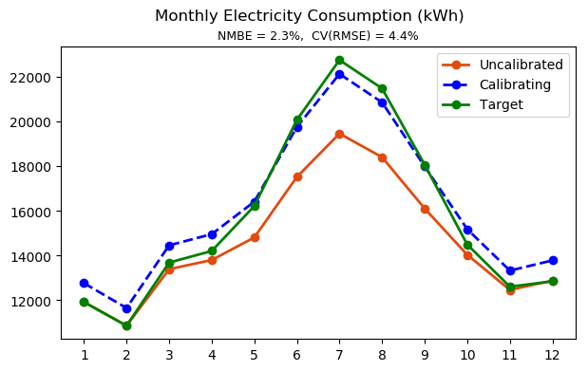

Manual Calibration – model tuning
Step 11
Exterior wall and floor thermal conductivity x 2
Floor thermal conductivity x 0.8
Exterior wall thickness x 0.8
Interior lighting and equipment power density x 1.1
Boiler and water heater efficiency reduced from 0.75 to 0.7
Occupancy density x 1.5
Air infiltration rate x 1.5

Slide 14
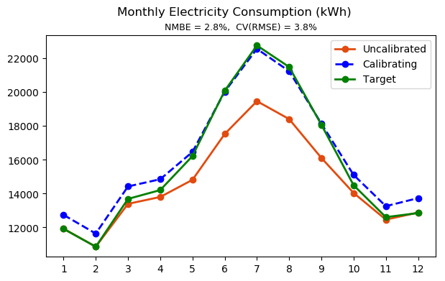
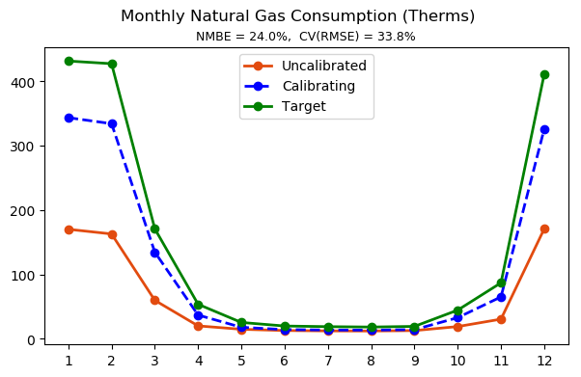
Manual Calibration – model tuning
Step 12
Exterior wall and floor thermal conductivity x 2
Floor thermal conductivity x 0.8
Exterior wall thickness x 0.8
Interior lighting and equipment power density x 1.1
Boiler and water heater efficiency reduced from 0.75 to 0.7
Occupancy density x 2
Air infiltration rate x 1.5

Slide 15
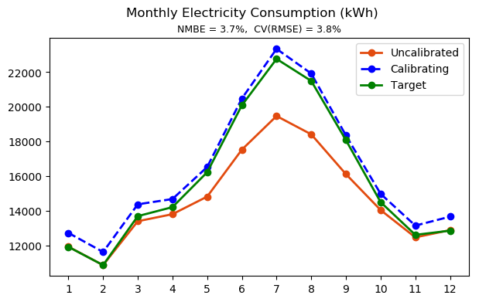
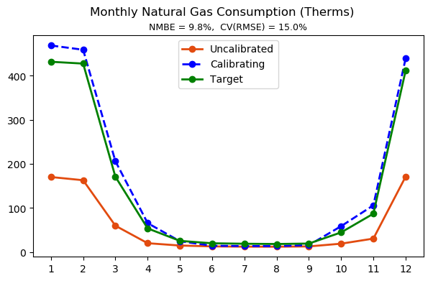
Manual Calibration – model tuning
Step 13
Exterior wall and floor thermal conductivity x 2
Floor thermal conductivity x 0.8
Exterior wall thickness x 0.8
Interior lighting and equipment power density x 1.1
Boiler and water heater efficiency reduced from 0.75 to 0.7
Occupancy density x 3
Air infiltration rate x 1.5

Slide 16
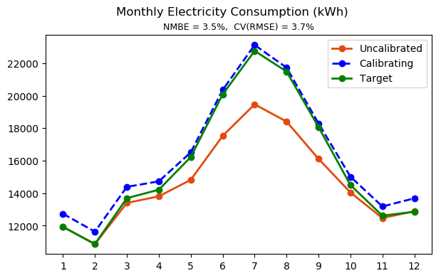
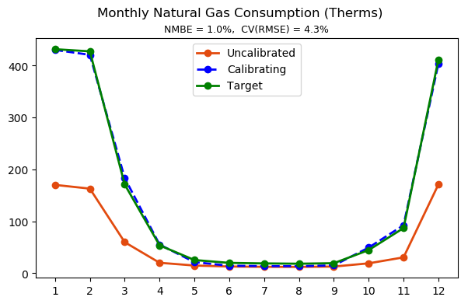
Manual Calibration – model tuning
Step 14
Exterior wall and floor thermal conductivity x 2
Floor thermal conductivity x 0.8
Exterior wall thickness x 0.8
Interior lighting and equipment power density x 1.1
Boiler and water heater efficiency reduced from 0.75 to 0.7
Occupancy density x 2.7
Air infiltration rate x 1.5

Slide 17
Hybrid Calibration – model tuning

Slide 18
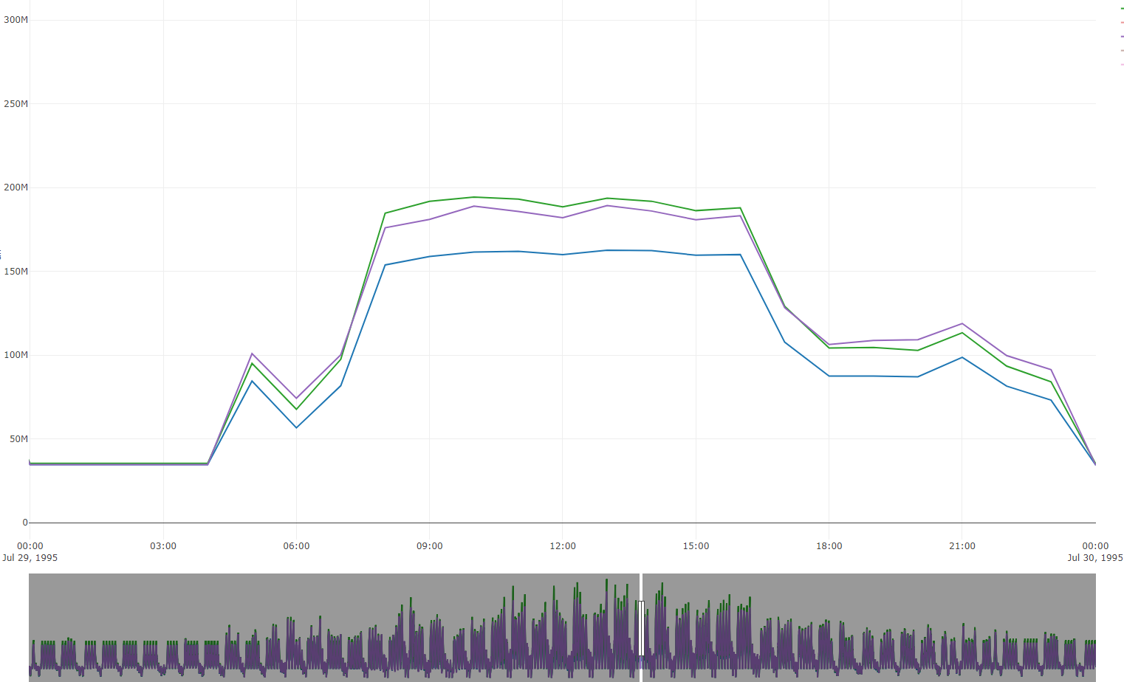
Comparison
Target (Ground Truth)
Calibrated
Uncalibrated

Slide 19
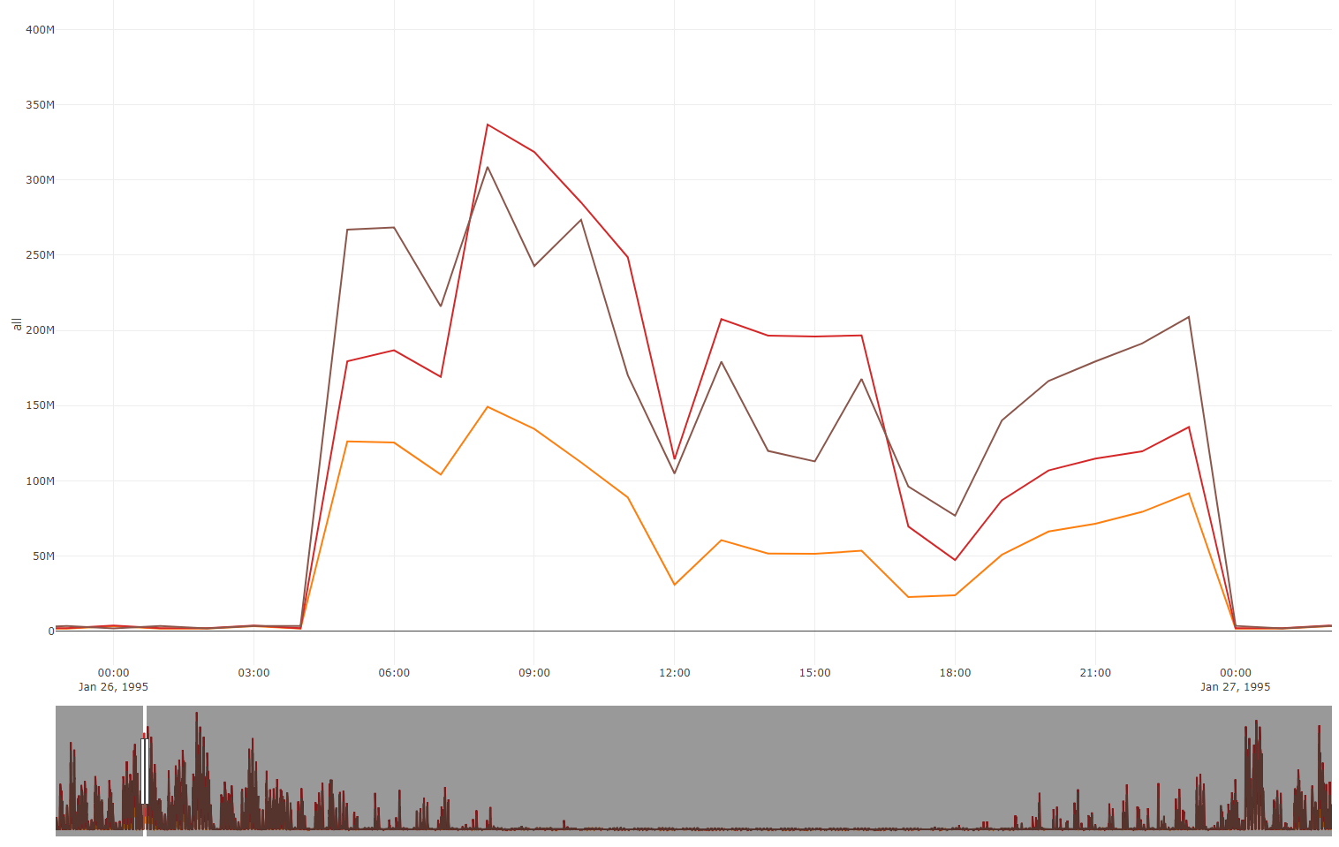
Comparison
Hourly gas consumption in heating season
Target (Ground Truth)
Calibrated
Uncalibrated

Slide 20
Manual Calibration – model tuning

Slide 21
Manual Calibration – model tuning

Slide 22
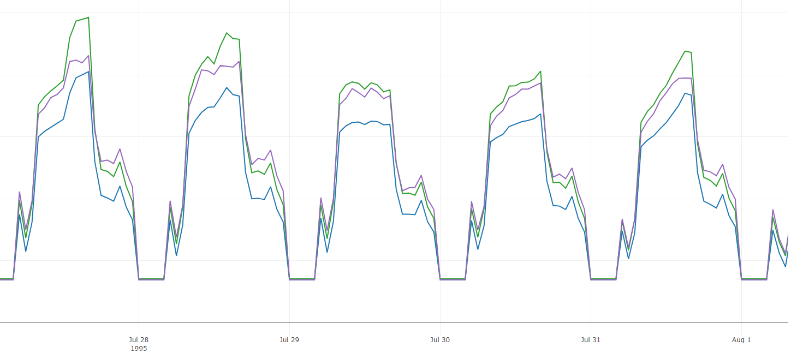
Manual Calibration – model tuning

